Slide 1




CREDIT RISK ANALYSIS
Course: Financial Data Science
Student: F. Amato
Professor: P. Giudici
Accademic year: 2022/23

Slide 2

ABSTRACT
Understand which are the key factors
for a certain level of credit risk to occur Compare the performance of different ML models capable to predict the credit risk level for a company in an year - given past years data
Keywords Financial Data Science • Credit Risk Analysis • Machine Learning

Slide 3




GITHUB REPOSITORY
https://github.com/Amatofrancesco99/credit-risk-analysis

Slide 4
TABLE OF CONTENTS
01
INTRODUCTION
02
DATA CLEANSING
03
EXPLORATORY ANALYSIS
04
ML MODELS
Problem definition and dataset description
Detect and correct corrupted records
Dataset analysis to derive domain knowledge
Credit risk level prediction and models comparison

Slide 5
01
INTRODUCTION

Slide 6

WHAT IS CREDIT RISK ANALYSIS
Credit analysis is a type of financial analysis that an
investor performs on companies to measure the issuer’s
ability to meet its debt obligations (calculated using
financial ratios, cash flow analysis, trend analysis,
and financial projections)
Credit analysis seeks to identify the appropriate level of
default risk associated with investing in that particular
entity's debt instruments
A review of credit scores and any collateral is also used to
calculate the creditworthiness of a business

Slide 7

DATASETS
The main dataset contains the following features (from 2015 to 2020), regarding
European companies:
Name: name of the company
Turnover: how quickly a company collects cash from accounts receivable or how fast the company sells its inventory
EBIT: indicator of a company's profitability
PLTax: company tax based on their cumulative income over their lifetime up until the filing date
MScore: The higher the M-score level of a company, the more likely the company engages in accounting frauds
Country: worldwide country of the company

Slide 8
DATASETS
NACE code: European statistical classification of economic activities
Sector 1: detailed description of the company's business activities
Sector 2: general sector
Leverage: the use of debt to amplify returns from an investment or project
ROE: measure of a company’s annual return
TAsset: assets owned by the company
Other accessories datasets have been downloaded from Kaggle to extract other useful
information, to gain more effective insights

Slide 9
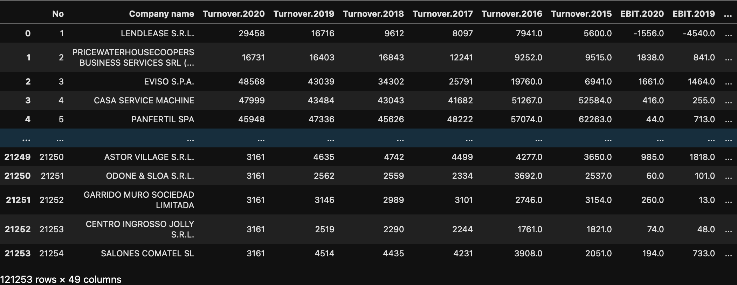
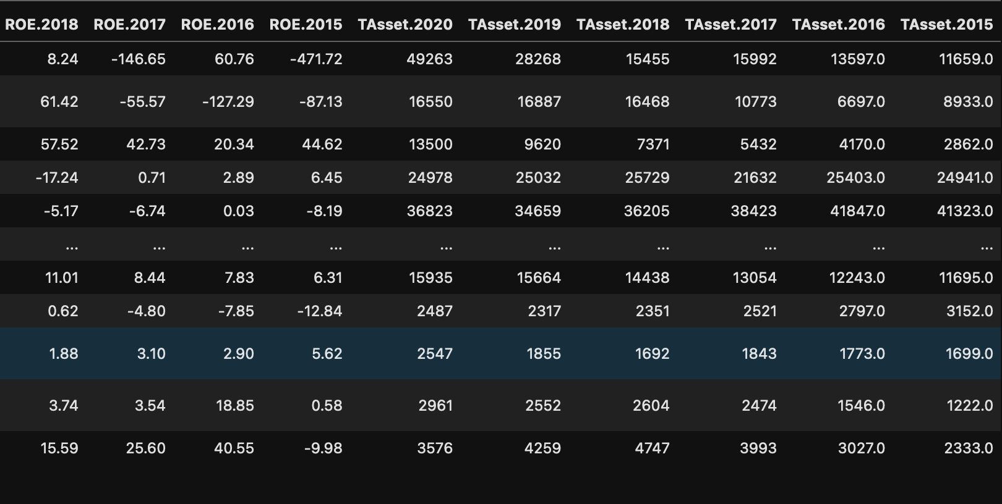
MAIN DATASET

Slide 10
02
DATA CLEANSING

Slide 11
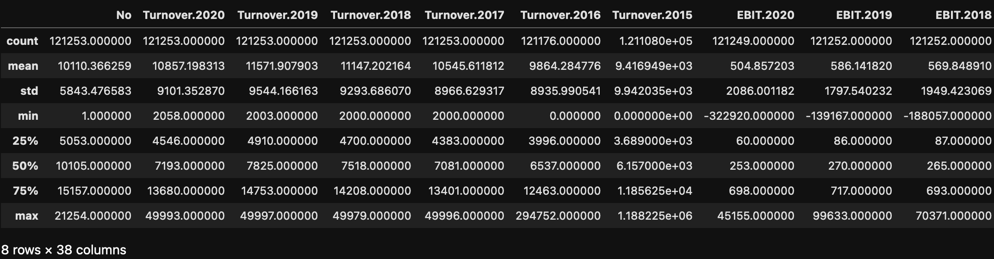
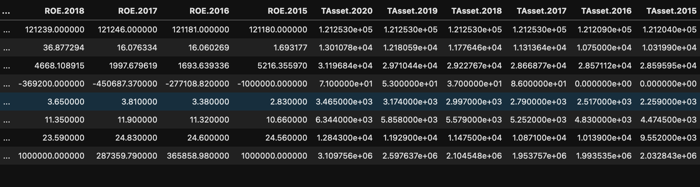
COLUMNS STATISTICS

Slide 12
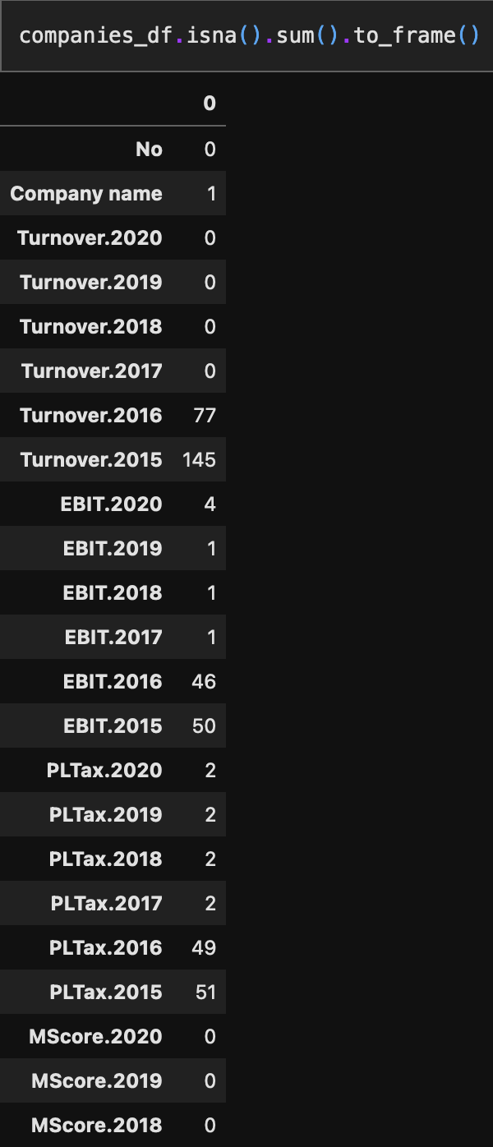
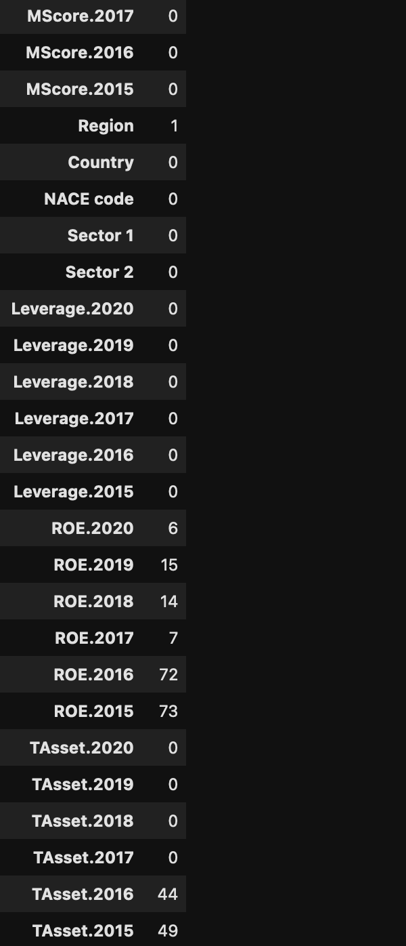
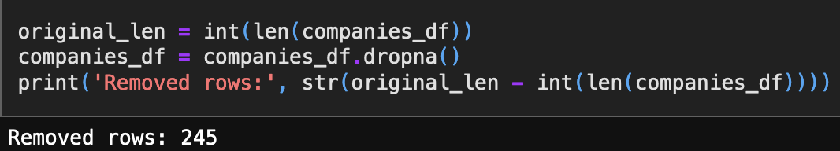
REMOVE NULL ELEMENTS

Slide 13
03
EXPLORATORY ANALYSIS

Slide 14

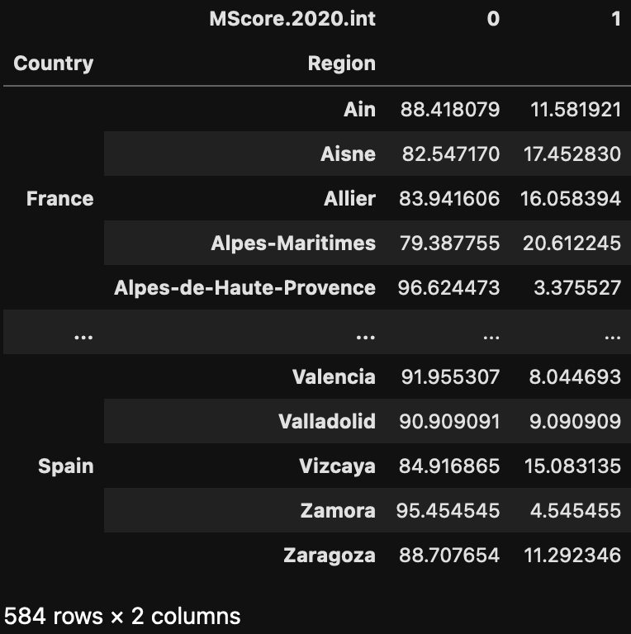
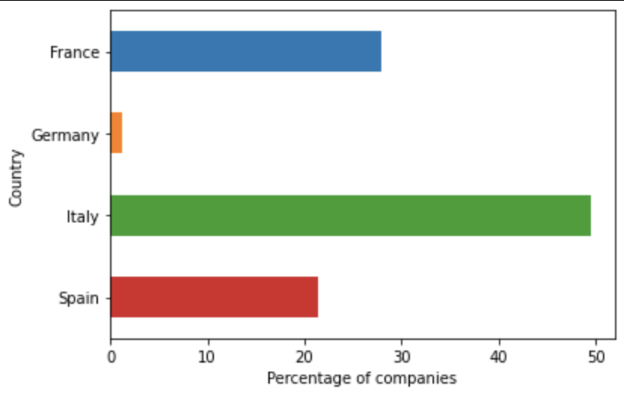
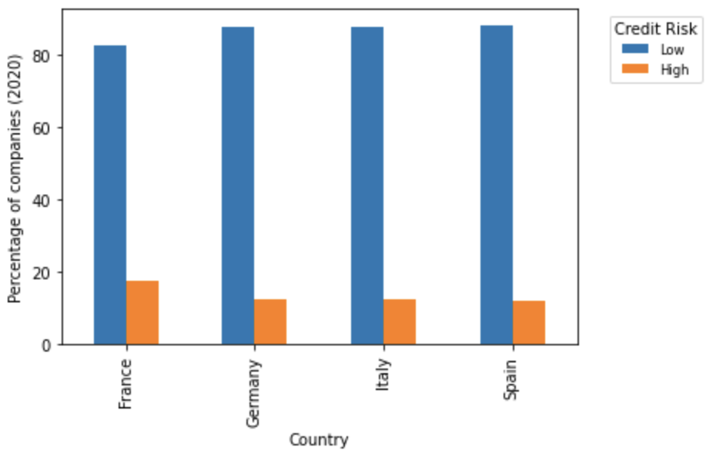
COUNTRIES
Credit risk
• Low = 0 ⇔ MScore ∈ [A, B]
• High = 1 ⇔ MScore ∈ [C, D]

Slide 15
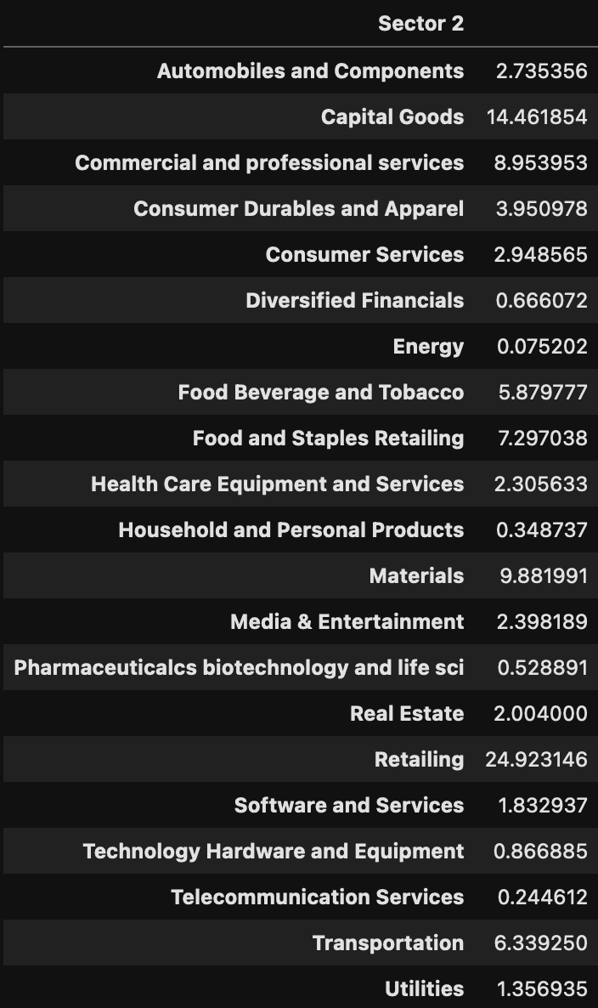
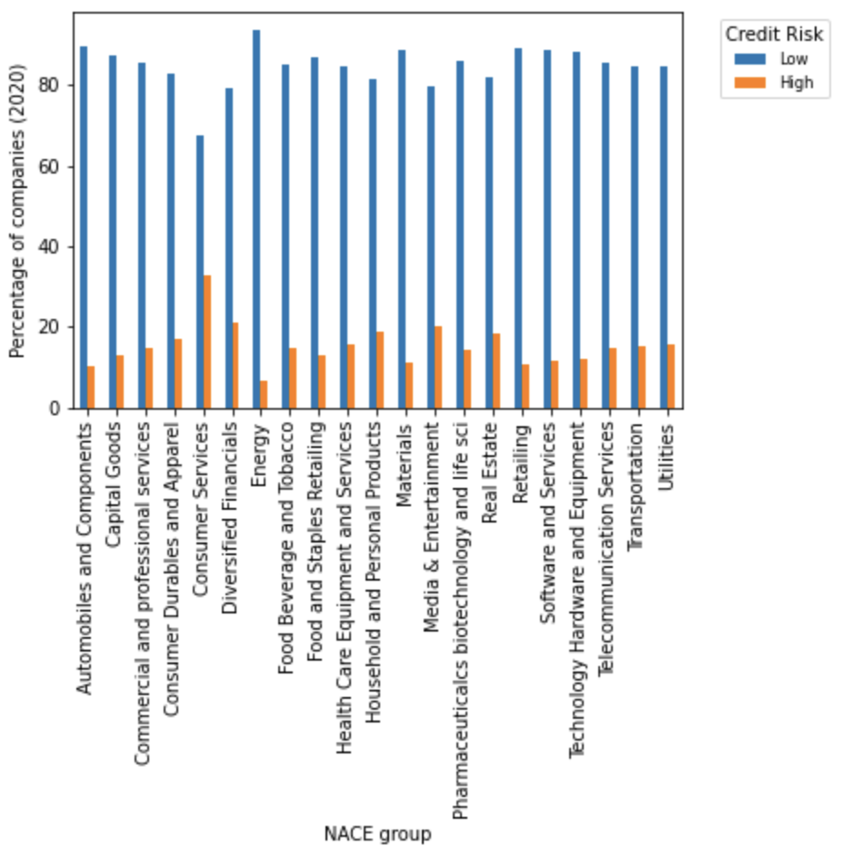
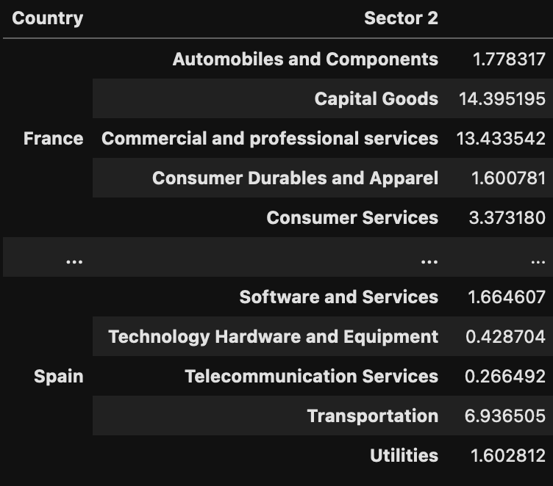
SECTORS
%
%

Slide 16
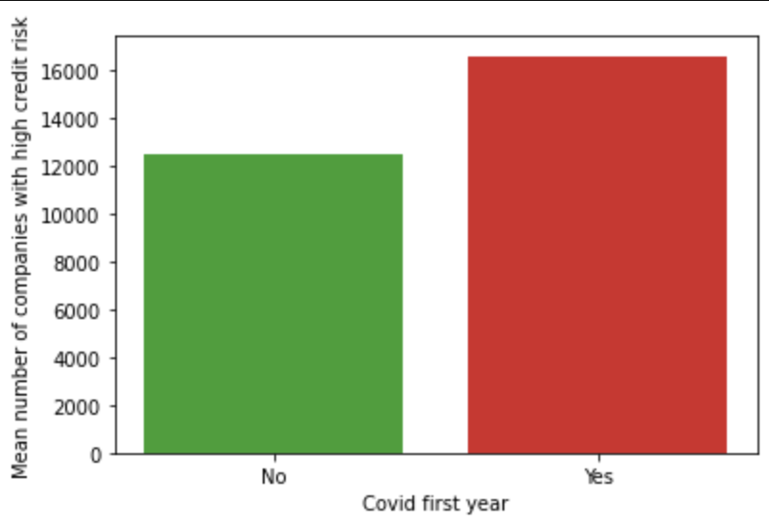
YEARS
Is it possible that after a company gets D credit risk level in an year, the consequent one still gets a D?
153 companies had a D credit risk level in 2019 and the consequent year
Did Covid-19 led an increase in the number of high credit risk companies?
Percentage increase in high risk level companies in 2020 (with respect to previous years): 32.6%
Correlation is not causation!

Slide 17
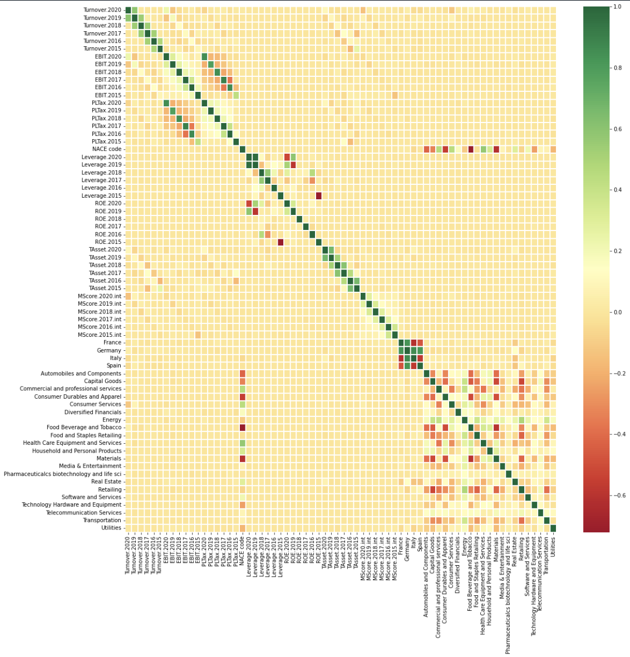
PARTIAL CORRELATIONS

Slide 18


04
ML MODELS

Slide 19
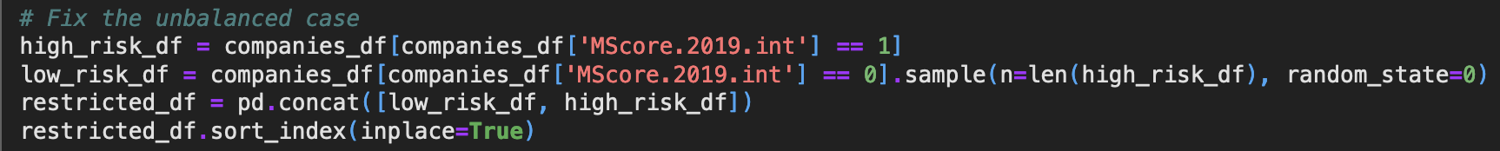
UNBALANCED CLASSES
Average number of low level credit risk companies: 107824
Average number of high level credit risk companies: 13184
Beware of the year choice, because of the already mentioned Covid-19 effect
Objective: predict 2019 credit risk level (selection through slider)

Slide 20
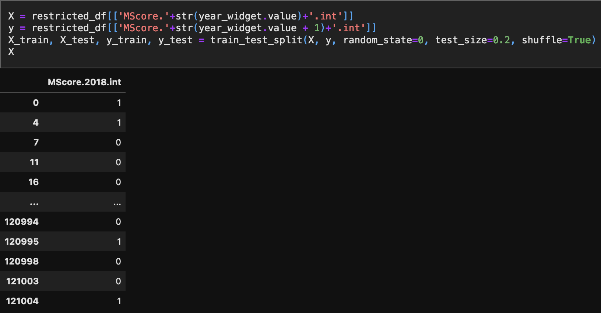
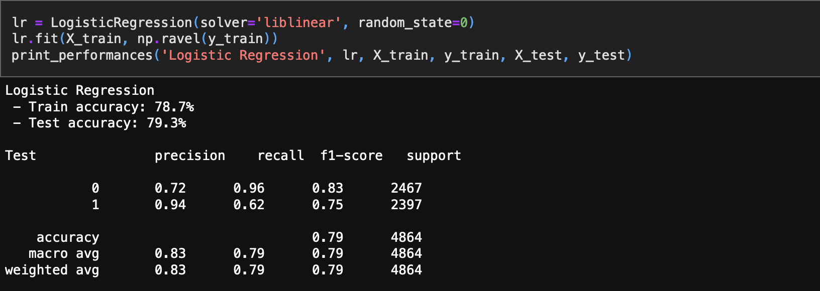
FEATURE SELECTION
Start considering a very easy model (LogReg)
Whether features values are ranging not in [0, 1], MinMax scaling has been applied
Easiest model: credit risk level of previous year, to predict the one of next year

Slide 21
FEATURE SELECTION
The overall obtained performances can be considered good, but what if we add
other features?
Adding other previous year data like EBIT, Leverage, Turnover, PLTax, ROE,
and/or constant features (general sector, country), singularly does not
significantly improve the performance metrics. Whereas, combining all of them
together it changes, but not so much to justify the loss of interpretability
Add more than one year old data, like all past years credit risk level scores
allows to improve significantly the performance metrics (5% of test accuracy
increase). Instead, adding other more than one year old data (EBIT, Leverage,
ROE, Turnover, …) does not improve so much the performance metrics
Same occurs when predicting other years credit risk levels (features weights
and performances metrics change due to complex variable in time dynamics)

Slide 22
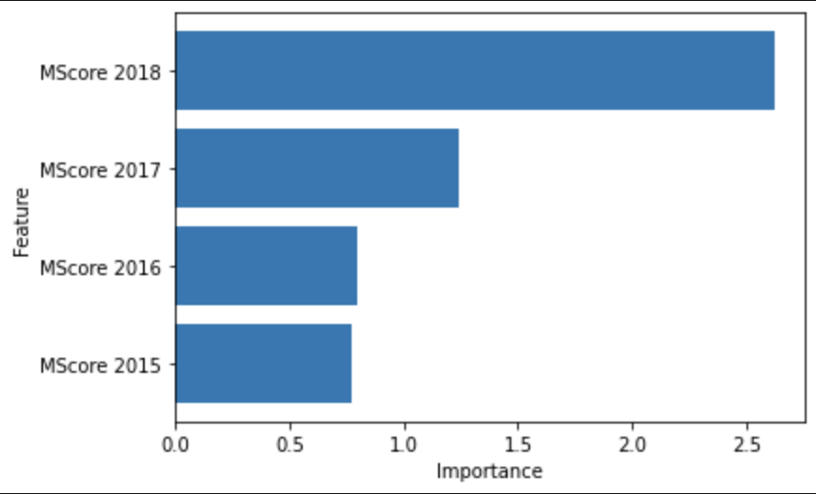
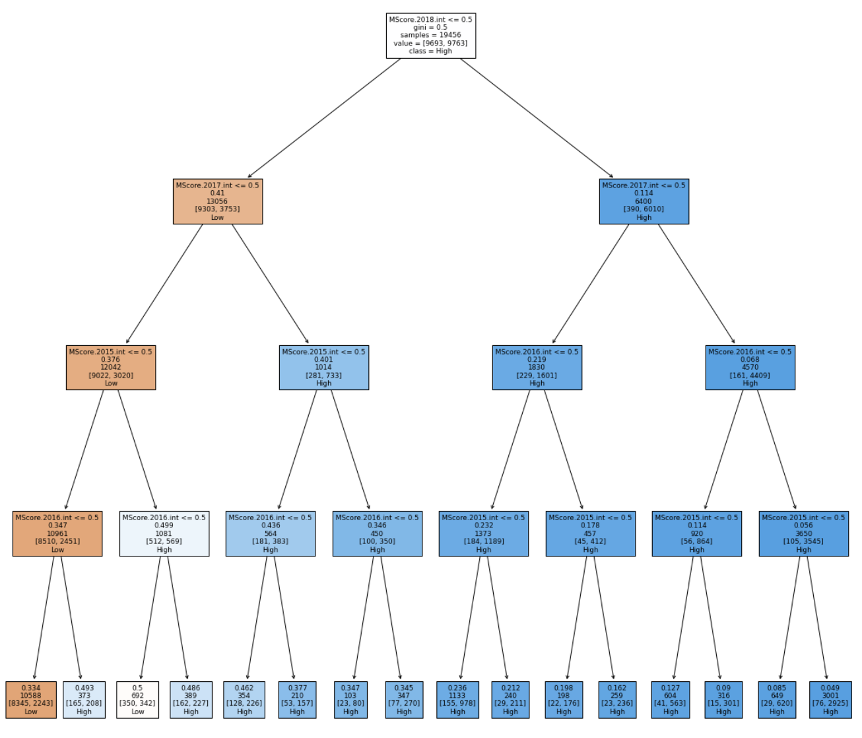
FEATURE IMPORTANCE AND DECISION TREE

Slide 23
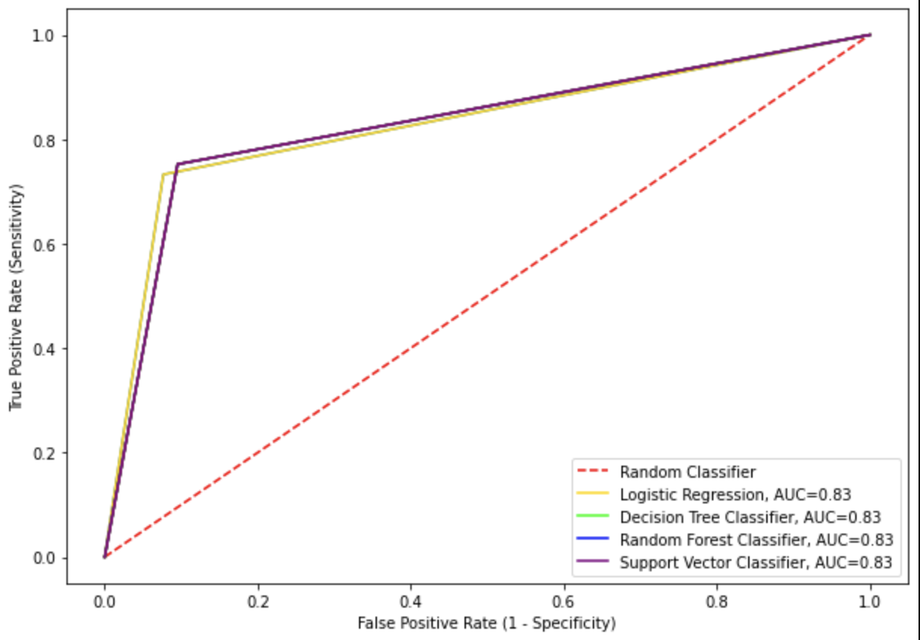
MODEL COMPARISON
What happens to performances metrics if we consider other more complex ML
models?

Slide 24


THANKS!
QUESTIONS?
Author‘s GitHub profile

